Slide 1
Physical factors in the generation of runoff
Learning objectives
Be able to describe the processes involved in runoff generation
Be able to distinguish between infiltration excess, saturation excess and subsurface stormflow runoff generation mechanisms and identify when and where each is more likely to occur
Be able to describe the physical factors resulting in the occurrence of runoff by the different mechanisms

Slide 2

Resources
Rainfall Runoff Module Online, http://hydrology.usu.edu/RRP, Chapters 1 - 3
Dingman Chapters 6, 9
Jeff McDonnell Website (http://www.cof.orst.edu/cof/fe/watershd/)
Benchmark papers in streamflow generation processes (many at http://www.cof.orst.edu/cof/fe/watershd/fe537/bpapers.html)

Slide 3
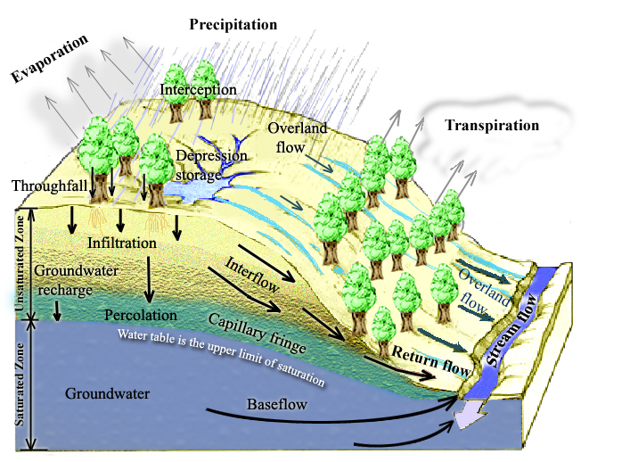
Physical Processes involved in Runoff Generation
Rainfall Runoff Processes
Notes:
Figure 1. Physical Processes involved in Runoff Generation.

Slide 4
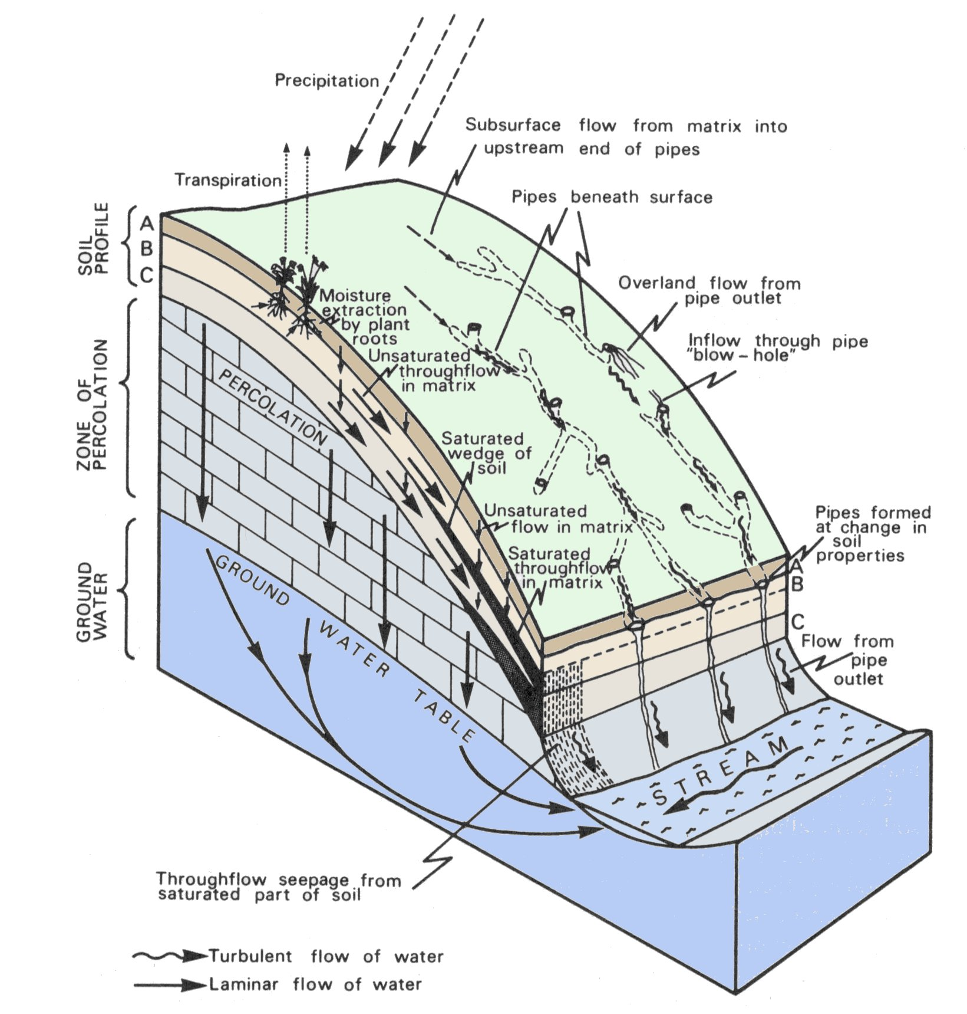
Pathways followed by subsurface runoff on hillslopes
(from Kirkby, 1978)
Notes:
Figure 2. Pathways followed by subsurface runoff on hillslopes

Slide 5
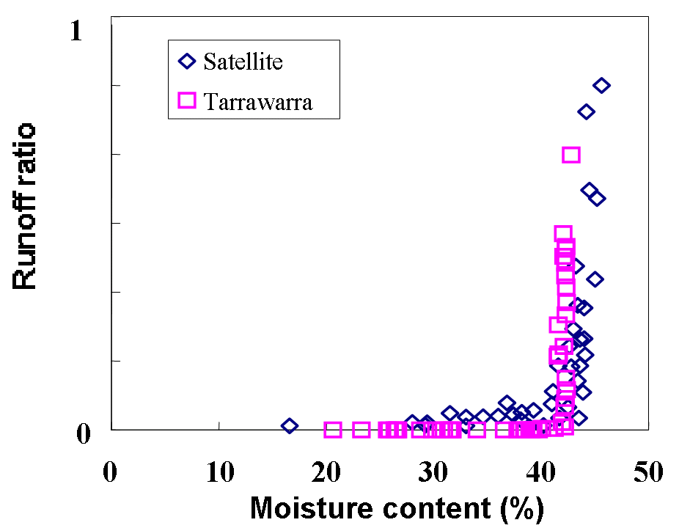
Threshold Hillslope Response
Relationship between runoff ratio and soil moisture content. (Woods et al., 2001.)

Slide 6
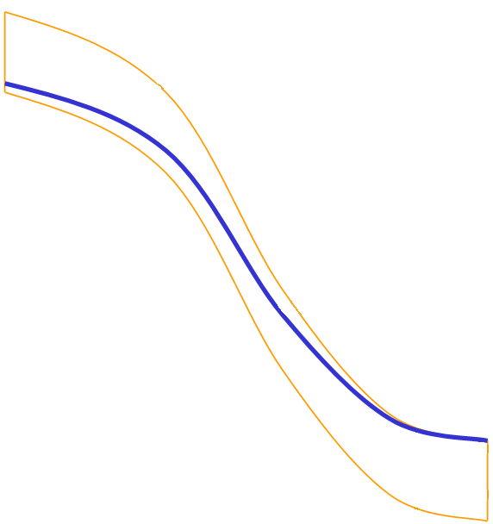
Relation between runoff and depth to groundwater
(b) 103 m from stream
(a) 14 m from stream,
Two different locations in the Svartberget catchment (Seibert et al., 2003)
Notes:
Figure 4. Relation between runoff and depth to groundwater for two different locations in the Svartberget catchment (Seibert et al., 2003)

Slide 7
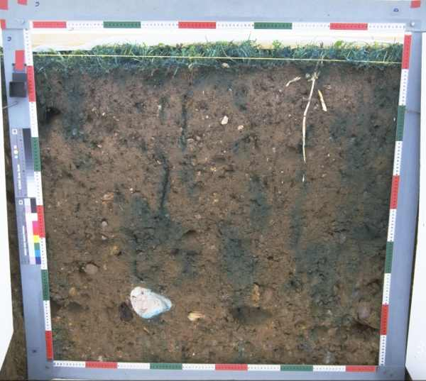
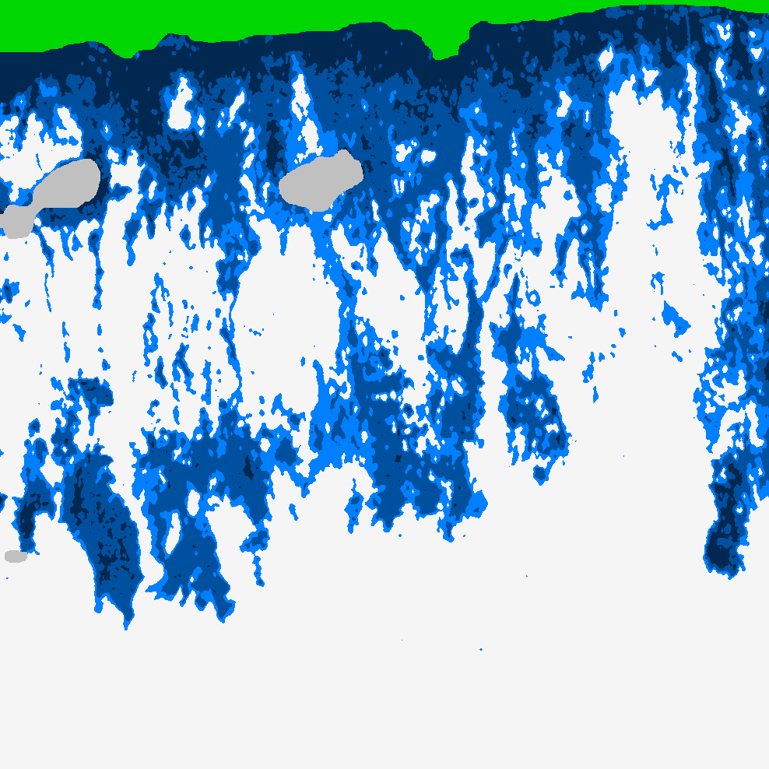
Infiltration follows preferential pathways
(a) Photograph of cross section through soil following dye tracing experiment. (b) Moisture content inferred from dye tracing experiment. (Courtesy of Markus Weiler)

Slide 8
Wetting may occur at depth before at the surface
See preferential pathway infiltration animation http://hydrology.neng.usu.edu/RRP/ (ch 2)

Slide 9
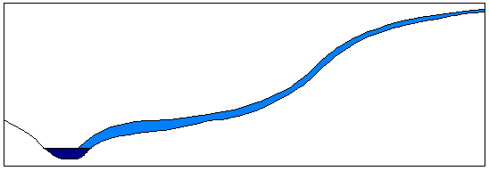
Runoff Generation Mechanisms
P
(a) Infiltration excess overland flow
(also called Horton overland flow)
f
P
P
q_{o}
f
(following Beven, 2001)
See infiltration excess runoff generation animation http://hydrology.neng.usu.edu/RRP/ (ch 2)

Slide 10
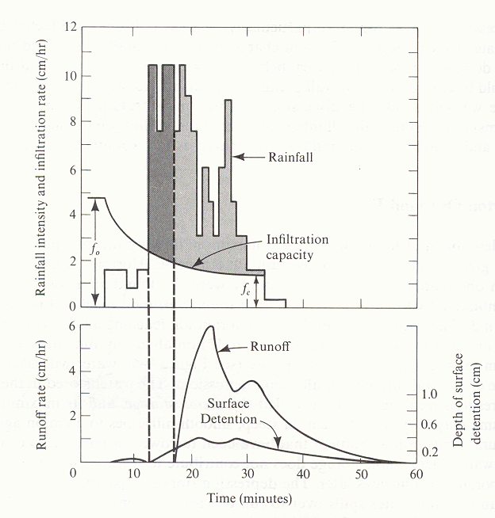
f₀
f₁
Figure 7. Rainfall, runoff, infiltration and surface storage during a natural rainstorm. The shaded areas under the rainfall graph represent precipitation falling at a rate exceeding the infiltration rate. The dark grey area represents rainfall that enters depression storage, which is filled before runoff occurs. The light grey shading represents rainfall that becomes overland flow. The initial infiltration rate is f₀, and f₁ is the final constant rate of infiltration approached in large storms. (from Dunne and Leopold, 1978)

Slide 11
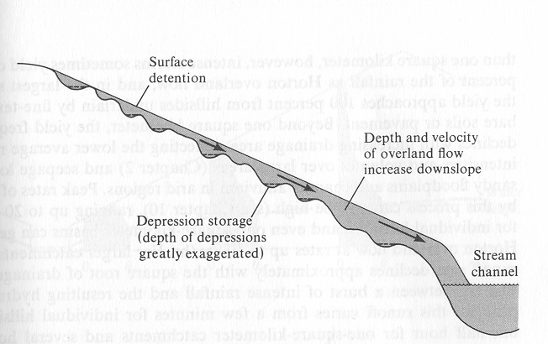
Overland flow moves downslope as an irregular sheet (from Dunne and Leopold, 1978)

Slide 12
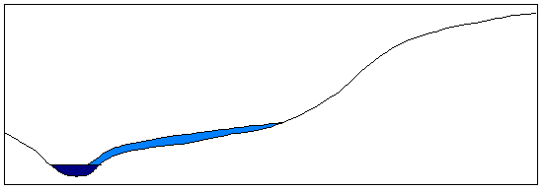
(b) Partial area infiltration excess overland flow
P
Fraction of area contributing to overland flow
q_{o}
P
P
f
(following Beven, 2001)

Slide 13
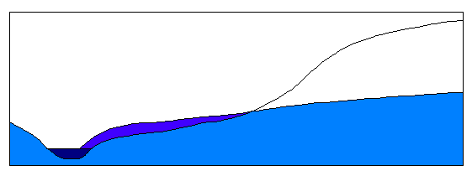
(c) Saturation excess overland flow
P
Variable source area
P
P
q_{o}
q_{r}
q_{s}
(following Beven, 2001)
See saturation excess runoff generation animation http://hydrology.neng.usu.edu/RRP/ (ch 2)

Slide 14
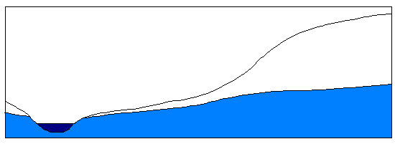
(d) Subsurface stormflow
P
P
P
q_{s}
(following Beven, 2001)
See subsurface runoff generation animation http://hydrology.neng.usu.edu/RRP/ (ch 2)

Slide 15
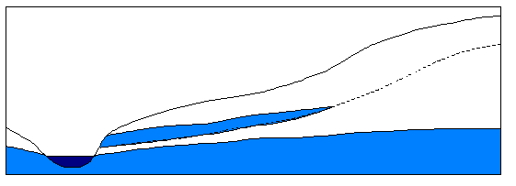
(e) Perched subsurface stormflow
P
Horizon 1
Horizon 2
P
P
q_{s}
Impeding layer
(following Beven, 2001)
See perched layer stormflow runoff generation animation http://hydrology.neng.usu.edu/RRP/ (ch 2)

Slide 16
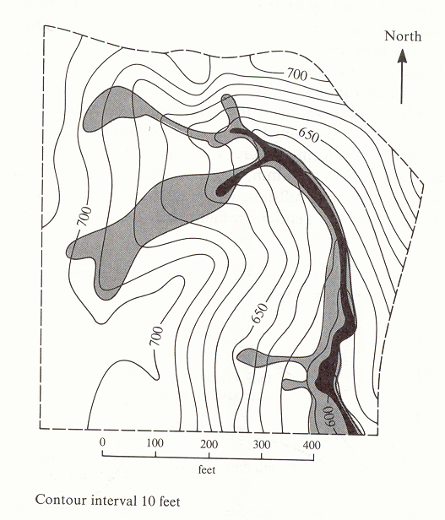
Map of saturated areas showing expansion during a single rainstorm. The solid black shows the saturated area at the beginning of the rain; the lightly shaded area is saturated by the end of the storm and is the area over which the water table had risen to the ground surface. (from Dunne and Leopold, 1978)

Slide 17
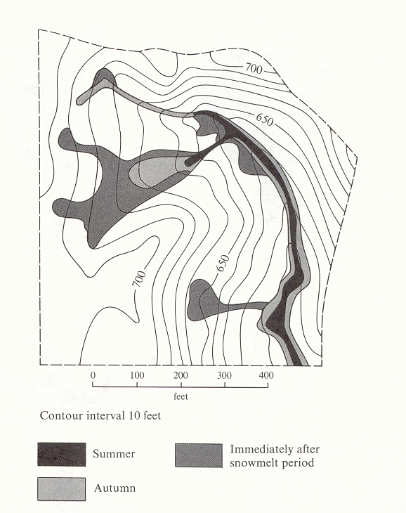
Seasonal variation in pre-storm saturated area (from Dunne and Leopold, 1978)

Slide 18
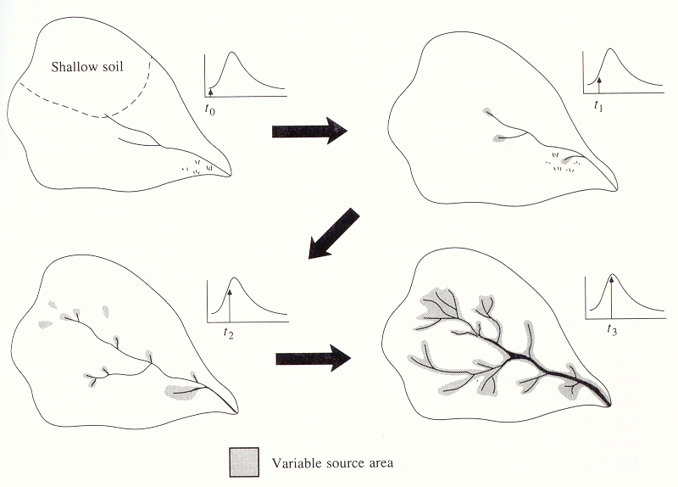
Variable Source Area Concept (from Chow et al, 1988). The small arrows in the hydrographs show how the streamflow increases as the variable source extends into swamps, shallow soils and ephemeral channels. The process reverses as streamflow declines.

Slide 19
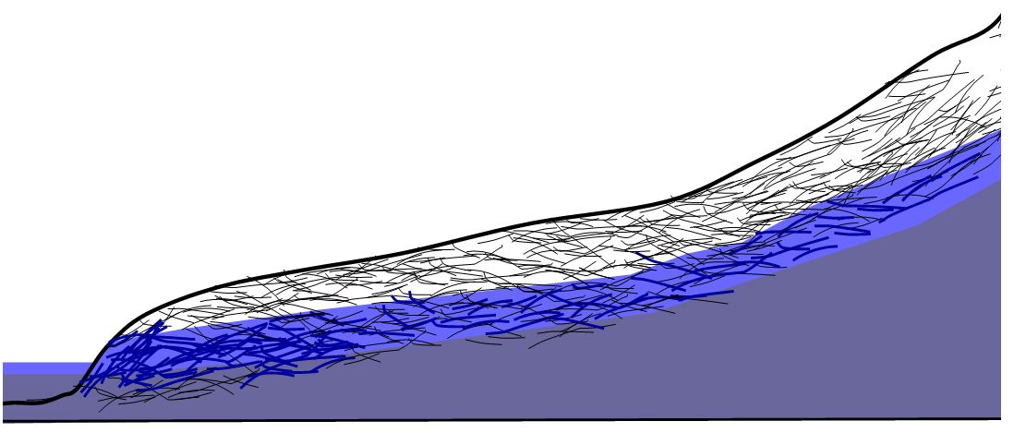
Transmissivity Feedback
Schematic illustration of macropore network being activated due to rise in groundwater resulting in rapid lateral flow.

Slide 20
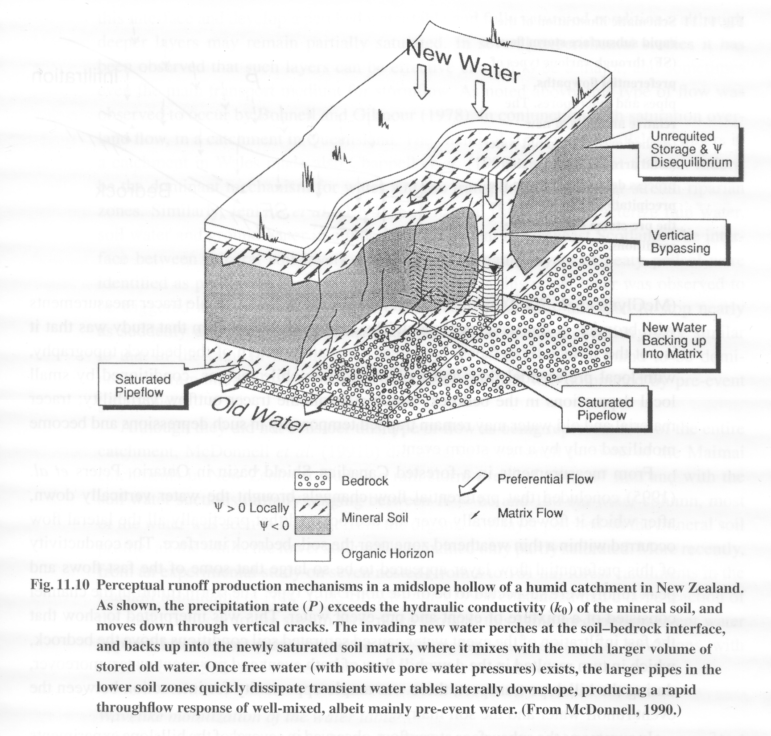
Brutsaert, 2005

Slide 21
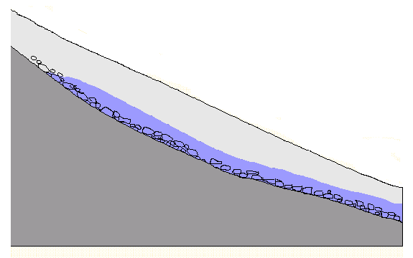
Rapid lateral flow at soil bedrock interface.
Soil
Low permeable bedrock

Slide 22
Features of subsurface stormflow
Unimpeded entry by new water from rainfall into the soil
Rapid downslope flow through preferential paths
Mixing with old water depending on rainfall intensity and soil moisture status
From Brutsaert, 2005, p454

Slide 23
(a)
Rain
Water
table
Baseflow
0 θ_{s} 0 θ_{s}
Rain
(b)
Water
table
Baseflow + subsurface stormflow
0 θ_{s} 0 θ_{s}
Rain
(c)
Direct precipitation
on saturated zone
Water
table
Return flow
Baseflow + subsurface stormflow
0 θ_{s} 0 θ_{s}
Groundwater ridging subsurface stormflow processes in an area of high infiltration rate.
Notes:
Figure 12. Groundwater ridging subsurface stormflow processes in an area of high infiltration rate.

Slide 24
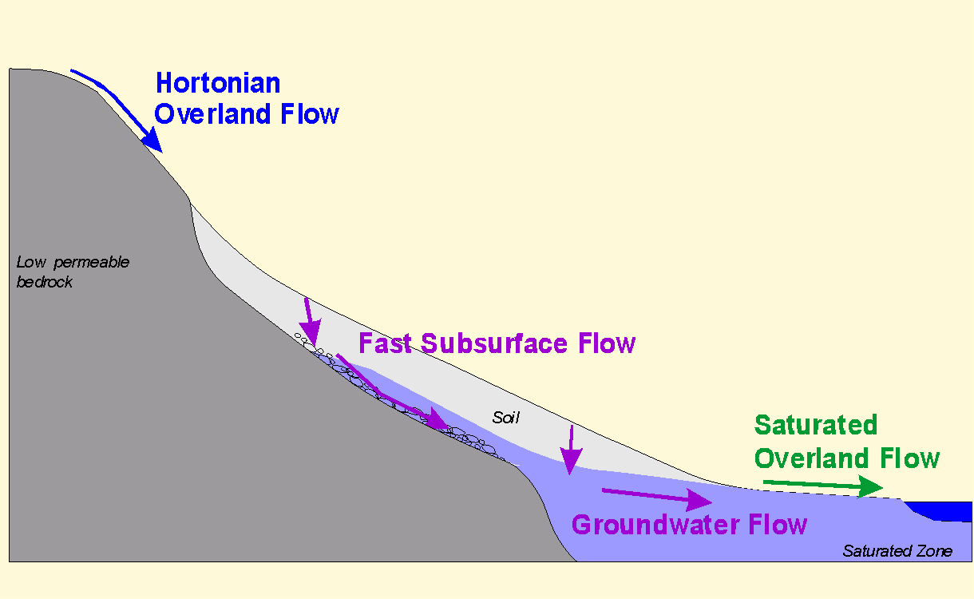
The particular runoff process that dominates is place and time dependent

Slide 25
What are the general hillslope pathways for runoff generation?
Evapotranspiration
Surface Water Input
Hortonian OF
Infiltration capacity
Saturation OF
Saturation
Variable
source area
Infiltration
Return flow
Soil regolith
Regolith subsurface flow
(interflow)
Percolation
Deeper groundwater aquifer
Aquifer subsurface flow
(baseflow)
Courtesy of Mike Kirkby
Notes:
Figure 13. Hydrological Pathways involved in different runoff generation processes. Infiltration excess pathways are shown in red. Saturation excess and subsurface stormflow pathways are shown in blue. Groundwater and baseflow pathways in black and Evapotranspiration is green.

Slide 26
Summary points
A bewildering range of hydrologic, climatic, topographic and soil conditions which favor different mechanisms
Extreme complexity suggests a single unifying model may not be possible or desirable
Distributed models allow exploration of consequences of simplifying assumptions and can lead to better understanding of the interplay between processes and pathways
Mathematical rigor may instill false confidence and undeserved sense of realism
Catchment scale parameterizations have difficulty representing spatial variability
From Brutsaert, 2005, p457-461

